Slide 1
Link to Video
https://uofi.box.com/s/5tze263a38yrc27u5pvkydjjcv0uppf8
Notes:
https://uofi.box.com/s/5tze263a38yrc27u5pvkydjjcv0uppf8

Slide 2
Brand Ambassadors
Group 2: Claudia Robles, Lasya Lalpet Venkata, Kristine Wong
Notes:
Hello! We are Group 2, discussing brand ambassadors’ effectiveness. My name is Kristine, and today I’m joined by Claudia and Lasya.

Slide 3
Agenda
01
04
02
05
03
06
Overview
Sentiment
Limitations
Search Interest
Stocks
Conclusion
Notes:
Before we get started, let me walk you through today’s agenda.
We’ll first explain the rationale and the value behind our project, followed by our main hypotheses and the key metrics we are looking at.
Followed by our introduction, Claudia will provide a heads-up as to the limitations within our project before we proceed to talking about these 3 key metrics.
These 3 key metrics are stocks, sentiment, and search interest which each of us will dive deeper into to try to answer our main hypotheses. Afterwards, we will combine all three of our analyses and their key findings to conclude whether brand ambassadors are effective and explain why they are so.

Slide 4

01
Overview

Slide 5
Why are brand ambassadors valuable?
$32.5 B
Is the size of the influencer market
75%
of brands have a dedicated budget for influencer marketing
Cultivate brand image
Credibility
Relatability
Ideals
Increase brand awareness
Drive sales
https://www.statista.com/statistics/1092819/global-influencer-market-size/
https://hbr.org/2022/11/does-influencer-marketing-really-pay-off
Notes:
Why are brand ambassadors valuable?
They help a brand cultivate its image, whether that is to make a brand seem more credible or relatable.
Brands can boost an ambassador’s image by association, and the same goes for ambassadors boosting a brand’s image by association.
This is why it is important that brands choose ambassadors that match their image and ideals.
Other reasons why they are valuable is their ability to boost brand awareness to underserved segments and being able to drive sales.
This is supported by the fact that nearly 75% of brands have a dedicated budget for influencer marketing.
It is important that these brand ambassadors or influencers actually support these goals. Our project was developed to validate these reasons and to explain what makes them more or less effective. This leads me to our main hypothesis.

Slide 6
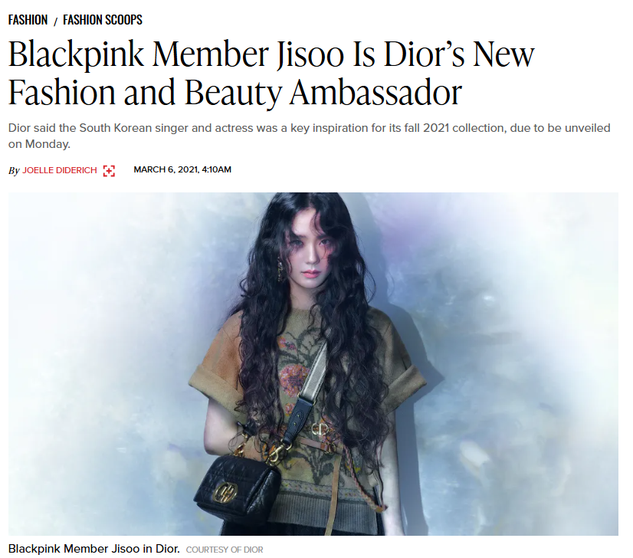
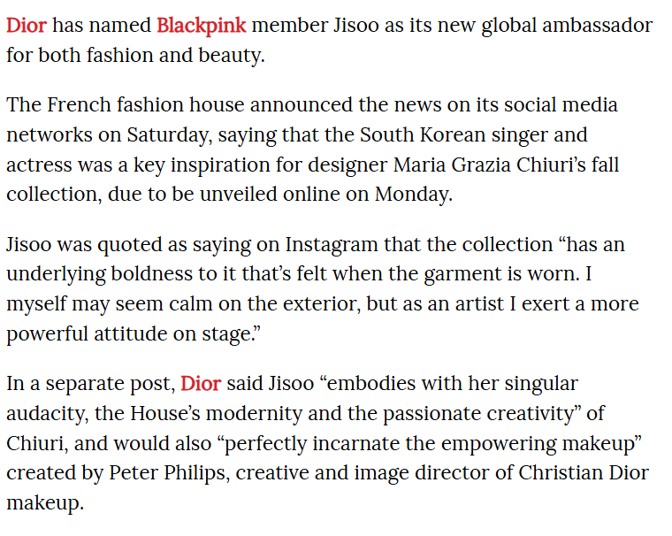
https://wwd.com/feature/blackpink-jisoo-dior-fashion-beauty-ambassador-1234768835/
Notes:
An example of this is Blackpink’s Jisoo, who was noted by creative directors of Dior, to embody “with her singular audacity, the House’s modernity and passionate creativity.”

Slide 7
Hypotheses
Introducing a brand ambassador improves a brand’s stock returns, image, and search interest.
Main Hypothesis
Sub Hypothesis 1
A brand ambassador’s occupation affects how effective a campaign is for a brand.
Sub Hypothesis 2
Being the first brand ambassador for a brand generates more impact compared to non-first ambassadors.
Notes:
Brand
Campaign timing: before and after
Ambassador
Occupation
First or Not First
Our main question is whether introducing a brand ambassador delivers measurable impact on a brand through stock returns (drive sales), improvements in brand image through media sentiment, and search interest (brand awareness) and also to what extent.
Apart from our main hypothesis, we wanted to look at whether characteristics like 1) the occupation and 2) the time of entry impacted an announcement’s effectiveness.

Slide 8




Targeting Mega Influencers
Nano (1k-10k)
Luxury Market Influencers
Marketing high-end products or services
Serve as a status symbol because of its exclusivity
Brand image much more important
Micro (10k-100k)
Macro (100k-1m)
Mega (1m+)
Notes:
To begin our analysis, we first narrowed down the influencers we were looking at to Mega Influencers with more than 1 million followers and to influencers within the luxury market. The luxury market is unique in which luxury goods are designed as a status symbol and marketed as exclusive, making their brand image more delicate than something like PepsiCo.

Slide 9
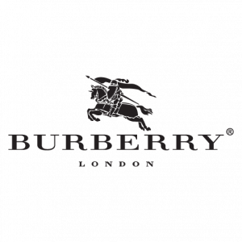

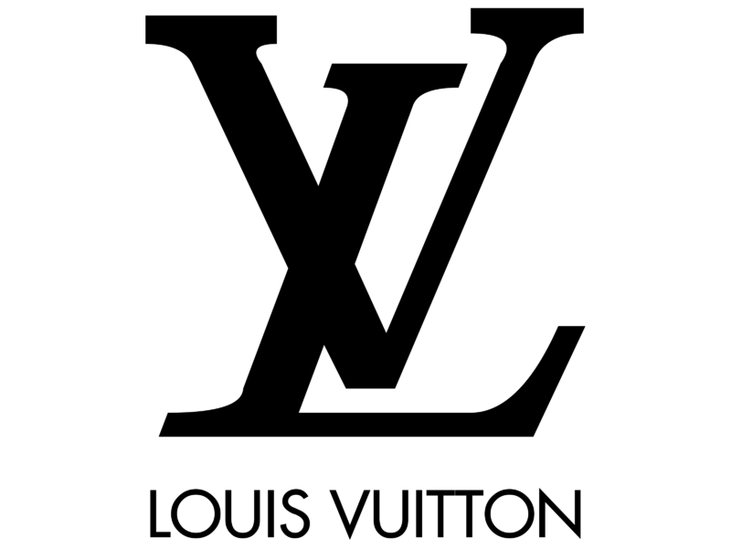


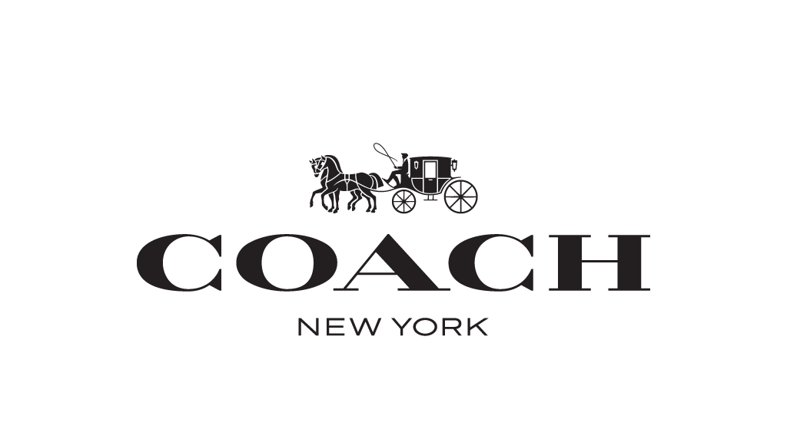
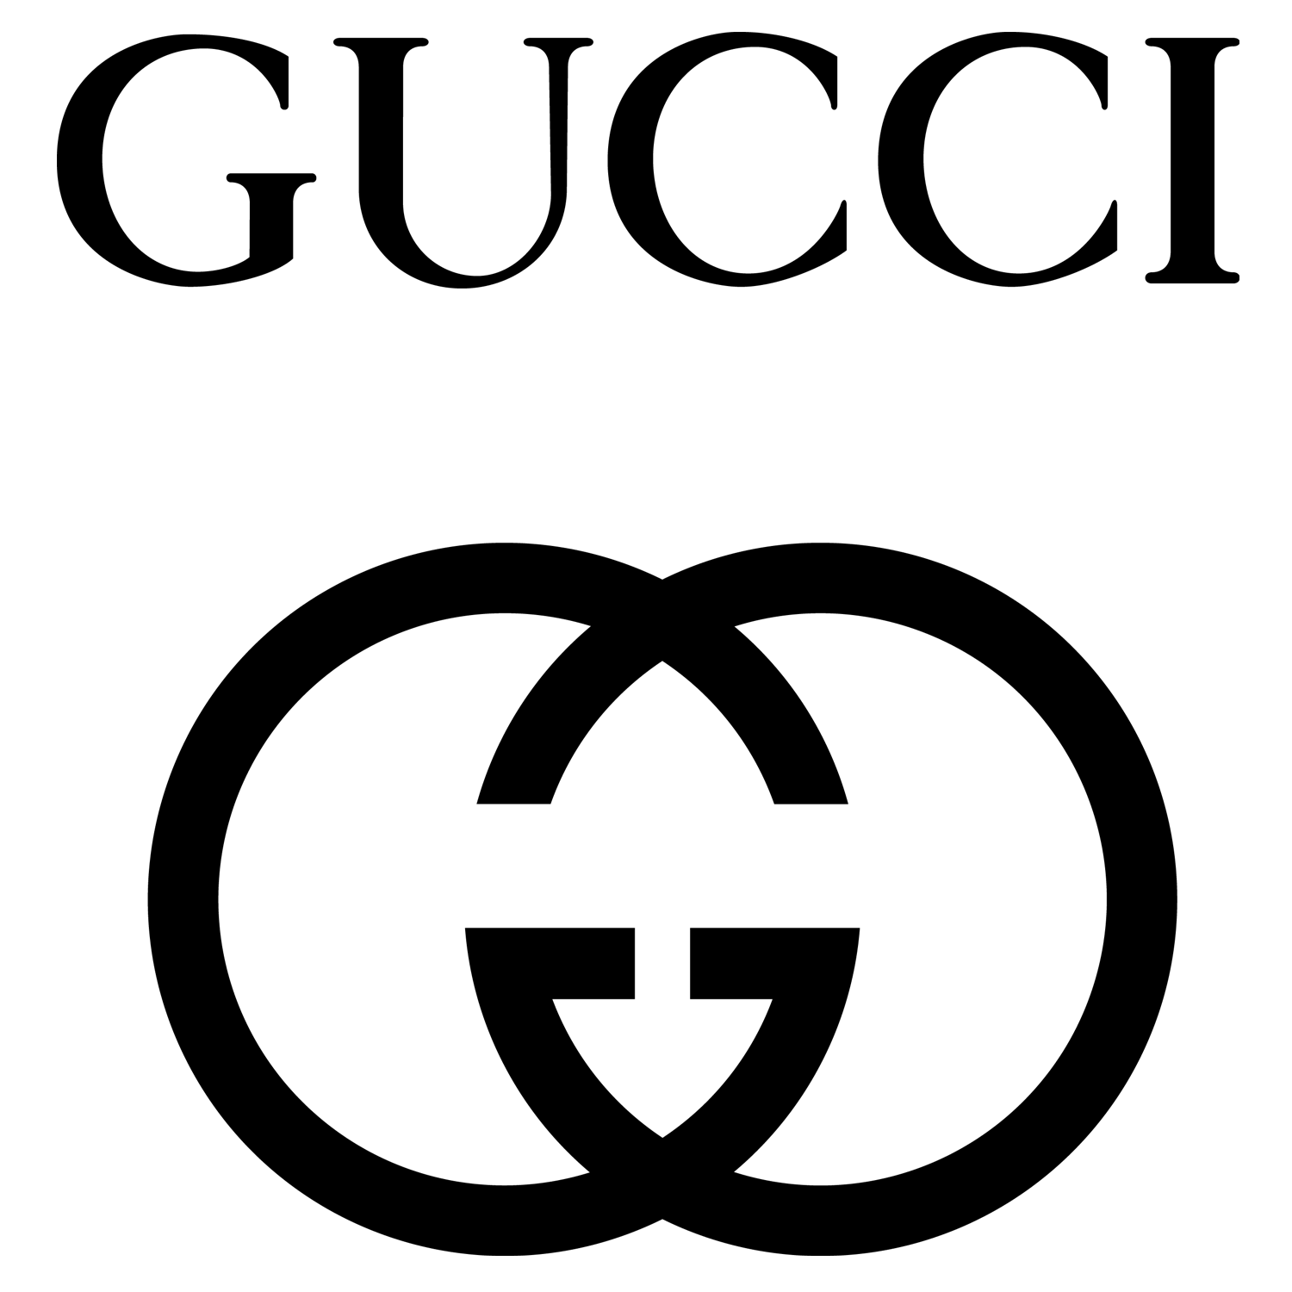

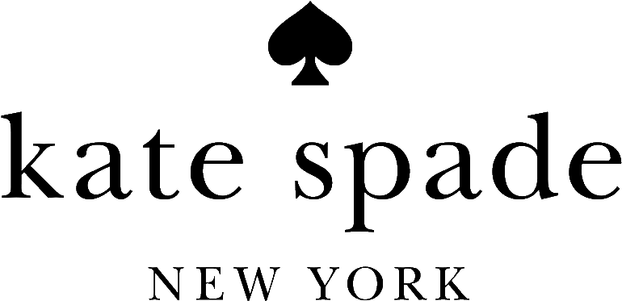



5 Core Brands & 7 Sub Brands
Notes:
Knowing we were targeting mega influencers within the luxury market, we narrowed our brands to 5 core ones.
These 5 core brands are publicly traded and the biggest within the luxury fashion space. Two of these brands are the parent companies to the listed featured brands. However, because these sub brands are not publicly traded, we had to measure its performance using the parent brand for one of our analyses.

Slide 10
15 Celebrities
Actor/Actress
Deepika Padukone, Zendaya
Jacob Elordi,
Nicole Kidman*
Barry Keoghan, Zhang Jingyi
Taraji P. Henson
Artist
Lisa
Lil Nas X, RM*, Billie Eilish
ASAP Rocky
Jennifer Lopez
Athlete
Jude
Bellingham
Serena Williams
*First ambassador of brand
Notes:
Of our 5 brands, we chose 15 of the most notable ambassadors over the 5 years. Although we tried to balance the pool of ambassadors by gender/age/occupation, some brands were naturally skewed to a particular type, had ambassadors that were not famous enough, or didn’t have enough in the first place. Nonetheless, we decided to proceed with this project at least as a case study for these specific 15 celebrities and 5 core brands. With this, Claudia will dive deeper into some of the other limitations.

Slide 11
02
Limitations

Slide 12
Considerations and Constraints
No True Control Group
Neutral Nature of News
All brands had ambassador campaigns
Couldn’t compare to ambassador-free brands
May limit value of sentiment analysis
Brand image impact may be implicit, and word-of-mouth driven
Overlapping Campaigns
Time Constraints
Multiple factors may affect interpretation
Difficult to isolate single campaign effect
Couldn’t include Hermes or other non-ambassador brands
Prioritized brands with rich ambassador coverage
Notes:
As we worked through this project, there were several key considerations and constraints we had to keep in mind.
First, we didn’t have a true control group, since all the brands in our analysis had ambassador campaigns, we weren’t able to compare them to brands without ambassadors.
Second, the nature of news articles posed a limitation. They often aim to be neutral or purely informational, which may reduce the effectiveness of sentiment analysis in capturing strong opinions.
Brand image impact may be implicit and word-of-mouth driven, making it difficult to capture through formal news sentiment alone
We also encountered overlapping campaigns. Many brand ambassadors are involved in multiple initiatives, making it challenging to isolate the impact of a single campaign.
ambassadors are introduced with a fashion collection and some independently
Lastly, we faced time constraints. We had to narrow our focus to brands with accessible and robust ambassador data. Although we considered including brands like Hermès, we prioritized depth of coverage over getting more and more brands in our analysis.

Slide 13
Analyzed 5 Brands and 7 Sub-Brands
Collected & Labeled 50+ Articles
Aligned with Search and Stock Data
What We Were Still Able to Do
Including Gucci, Louis Vuitton, Burberry, Coach, and more
Spanning before, during, and after ambassador annoucements
Integrated external metrics to assess impact
Notes:
Even with those challenges, we were still able to accomplish a lot.
We analyzed 12 luxury brands and sub-brands, including big names like Gucci, Louis Vuitton, Burberry, and Coach.
Across those brands, we collected and labeled over 50 news articles, capturing coverage from before, during, and after ambassador announcements to track change over time.
And importantly, we aligned our sentiment findings with external data—such as Google Search interest and stock performance—to better assess the broader impact of these campaigns

Slide 14
03
Stocks

Slide 15
Objective: Explain stock returns
Looking At
Whether the announcement of a brand ambassador has quantifiable returns in the form of above average stock returns.
Relevance
By understanding the financial implications, brands can better tailor ambassador campaigns depending on their long-term goals.
Notes:
As I mentioned earlier, one of our key metrics is stocks, we are looking at whether an announcement has quantifiable returns. By understanding whether there are quantifiable returns and to what extent or by what ambassador characteristics, brands can better tailor their campaigns to achieve their long term goals.

Slide 16
Method: CAAR Analysis
Purpose
Measure aggregated effect of a company’s stock price in response to a specific event
Process
Utilized Market Method
Straightforward model to generate
Less data collection requirements
Compared stock’s growth to predicted growth according to market trends
Built on linear regression
Differences are noted as “abnormal returns”
Results Extracted
Abnormal returns over time at the ambassador and brand level, segmented by ambassador characteristics
Notes:
To do this, we analyzed stock returns using CAAR or cumulative average abnormal returns. It is intended to…
Potential explanations as to why and confounding factors limiting analysis results.

Slide 17
Method: CAAR Analysis
Data Utilized
Each stock’s adjusted closing price and market index’s closing prices for associated announcements
Estimation Window: 5 months before the event to account for seasonality
Event Window: 2 weeks before and after the ambassador announcement to better isolate effect and account for anticipation
Brand | Sub Brands | Stock | Exchange | Market Index
Louis Vuitton |  | MC.PA | Euronext Paris | CAC 40
Kering | Gucci, Saint Laurent, Bottega Veneta, Balenciaga | KER.PA | Euronext Paris | CAC 40
Moncler |  | MONC.MI | Borsa Italiana | FTSE MIB
Burberry |  | BRBY.L | London Stock Exchange | FTSE 100 ^FTSE
Tapestry | Coach, Kate Spade, Stuart Weissman | TPR | New York Stock Exchange | S&P 500 ^GSPC
Notes:
As for the actual data we collected, we collected…
For those of you unfamiliar, each stock is traded on an exchange and its performance is typically indexed using a specific metric, so we chose the most popular one for each exchange.
Over two main time frames: the estimation window (the timeframe we built the model on) and the event window (2 weeks before and after the ambassador event). We chose these timeframes….

Slide 18
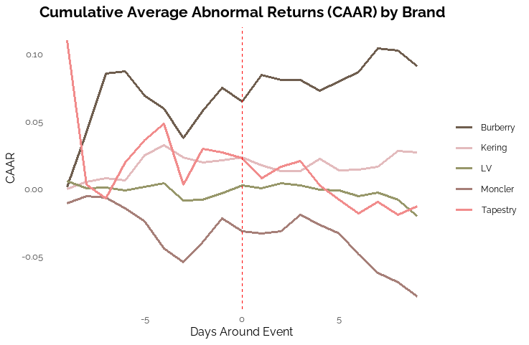
Results:
CAAR by Brand
Over Time
 | Total | Before | After
Burberry | 9% | 7% | 2%
Kering | 3% | 2% | 1%
Louis Vuitton | -2% | 0% | -2%
Moncler | -8% | -2% | -6%
Tapestry | -1% | 3% | -4%
Burberry and Kering (Gucci, STL, Bottega, Balenciaga) w/ positive CAAR
Moncler declining over the event window
Notes:
We first analyzed the impact by brand. On the left, you can the variation in abnormal returns over time, while the right is a brief summary table. You can interpret CAAR as something performing x percent better than the market at a certain time period. For example, Burberry on day 0 is currently performing around 7.5% better than its market average over the event window. Looking at the brands individually, we see there is no clear trend for growth, but instead each brand has its individual trend. Burberry clearly soars above the rest, steadily rising. Kering and LV show steady trends, while Moncler showed the most dismal performance after release. To characterize why this may be so, we dug into the individual ambassador and their trends.

Slide 19
Results: CAAR by Ambassador
Rising stars
Chinese luxury market
Localized and cultural resonance defined success with Zhang
Utilizing rising and younger stars appeals to younger consumers with improved digital impact and relevance
Notes:
This chart illustrates the cumulative returns by ambassador. Similarly, there are no clear trends, with equal amounts of individuals with negative and positive returns. However, something interesting to note is Zhang Jingyi’s strong performance. Digging deeper into her background, Zhang is our only Chinese celebrity, and this strong performance can be attributed to Burberry’s strong push into the Chinese market and China’s now dying luxury boom at the time. Among our portfolio, she is the only Asian celebrity with a positive CAAR, in contrast to Deepika, RM, and Lisa.
Another explanatory factor could be the age of the stars and their recent leaps to stardom. At the time of announcement, most of our stars were at least 5 years into their career. However, 3 out of our 5 with positive CAAR were only 3-4 years into their careers. Their success could be attributed to appeal to younger consumers (Gen Z and millennials), greater digital impact, and greater cultural relevance and resonance.

Slide 20
Results: Change in CAAR by Ambassador
Exclusivity and cultural match are key
K-pop star effect: over-commercialization diluting exclusivity, cultural mismatch
K-pop star effect
Legacy celebrity
Vital Voices: women empowerment
Notes:
Apart from looking at the total CAAR, we also looked at the change 2 weeks before and after the announcement.
Surprisingly, most CAAR values decrease after the actual announcement. This could be due to speculation beforehand by investors, potential overhype, or an announcement not matching expectations.
We looked into the two individuals with the largest decreases. First was RM. We suspect this to be due to concerns about over-commercialization. By introducing this fan-driven, youth-oriented K-pop audience, this may dilute the luxury brand’s exclusivity and value. They may see this as a cultural mismatch between the brand, Bottega Veneta, and RM’s main clientele.
Second was Serena Williams. We found that her announcement was mainly centered around women empowerment and Stuart Weitzman’s Vital Voices campaign, which was completely our of expectation. We could either take this as investors disapproving of an empowerment campaign, or there may be unidentified events occurring with Tapestry or its other sub-brands impacting her success.

Slide 21
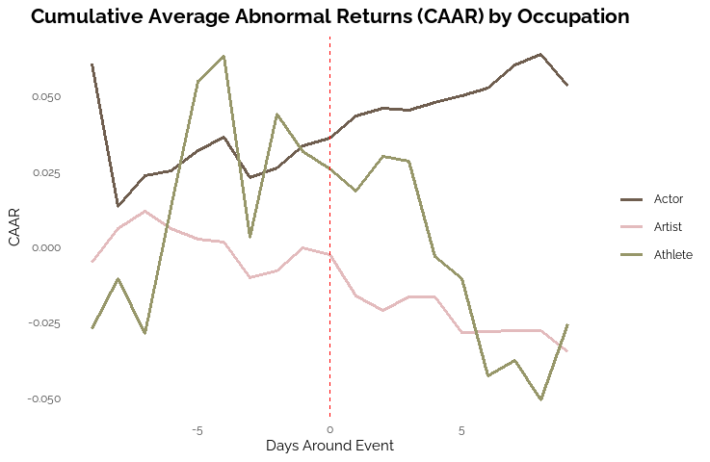
Results: CAAR
by Occupation
Actors showed the strongest positive stock response, while artists experienced a decline.
 | Total | Before | After
Actor | 5% | 3% | 2%
Artist | -3% | 0% | -3%
Athlete | -3% | 3% | -6%
Notes:
Having looked at the impacts of having a relevant and culturally compatible ambassador, we can now turn to other potential factors impacting an ambassador’s success, namely occupation.
Actors showed… while artists…., likely an indication of the K-pop effect seem earlier. Athletes show a sharp rise before and sharp decline afterwards. However, there are only two athletes within our sample, with one of them being Serena Williams which we saw earlier on.
All in all, actors appear to perform much better compared to other occupations. Fans of artists/singers typically are on the younger side, while fans of actors or athletes span a wider range of ages. The difference in disposable income could explain the difference in market reaction. Another reason is that actors could appear more “exclusive” or “professional.” All of our artists appeal to a younger audience, and they tend to be more relatable due to a greater social media presence and simply because of their age. This fights against goal of “exclusivity” most luxury brands aim for.

Slide 22
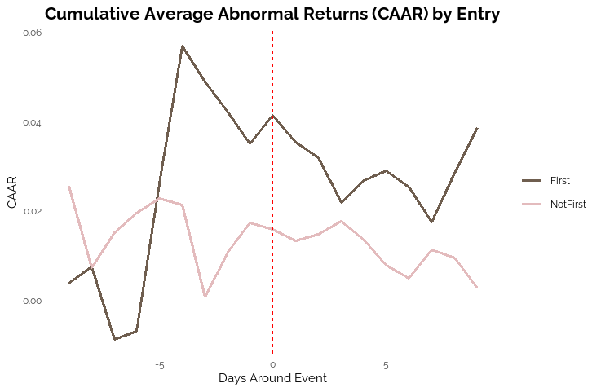
Results: CAAR
by Entry
 | Total | Before | After
First | 4% | 4% | 0%
Not First | 0% | 2% | -1%
First-ever ambassador saw higher total abnormal returns, indicating the effect of novelty.
Notes:
Lastly, let’s look at whether being the first ambassador affects an announcement’s success. We find that it does, even though we only have 2 who were the first ambassador of a brand, but this would characterize Nicole Kidman’s stellar performance we saw in our CAAR by ambassador graphics. This success can be explained a sense of novelty from being the first of the first.

Slide 23
Key Findings: Stocks
Ambassador Campaigns Influence Stock Returns
Key Factors
Localized and culturally resonant
Digital presence
Brand and ambassador compatibility
Actors Have Greater Impact
Artists likely suffer from being too relevant or relatable, detracting from exclusivity
First Ambassadors Have Greater Impact
Novelty

Slide 24
04
Sentiment

Slide 25
Objective: Measure tone shifts in media
Looking At
Changes in sentiment before, during, and after ambassador announcements.
Relevance
This helps uncover how ambassador campaigns influence media narratives and emotional perception, supporting brand stategy and reputation management.
Notes:
Our objective for this portion of the project was to measure tone shifts in media coverage, specifically how sentiment changed before, during, and after ambassador announcements.
We’re looking at these shifts to understand whether ambassador campaigns influence the media’s tone or emotional framing.
This is especially relevant for brand strategy and reputation management, as companies increasingly rely on public sentiment to guide communication decisions.

Slide 26
Method: Sentiment Analysis
Definition
Process
Evaluating the emotional tone or text using polarity scores (positive, negative, neutral).
Cleaned and preprocessed article text, then applied TextBlob to extract sentiment polarity for each article.
Data Utilized
Results Extracted
50+ news articles across 10 brands, categorized by ambassador and campaign timeline (before, during, after).
Quantified shifts in sentiment over time and across brands; visualized tone variation by brand, occupation, and campaign stage.
Notes:
For our method, we used sentiment analysis to evaluate the emotional tone of news articles, classifying them as positive, negative, or neutral using polarity scores.
We first cleaned and preprocessed the text, then used TextBlob to calculate sentiment polarity for each article.
Our dataset included 50+ articles across 10 luxury brands, sorted by ambassador and campaign timing—before, during, and after announcements.
This allowed us to quantify sentiment shifts over time and visualize tone differences by brand, occupation, and announcement phase.

Slide 27
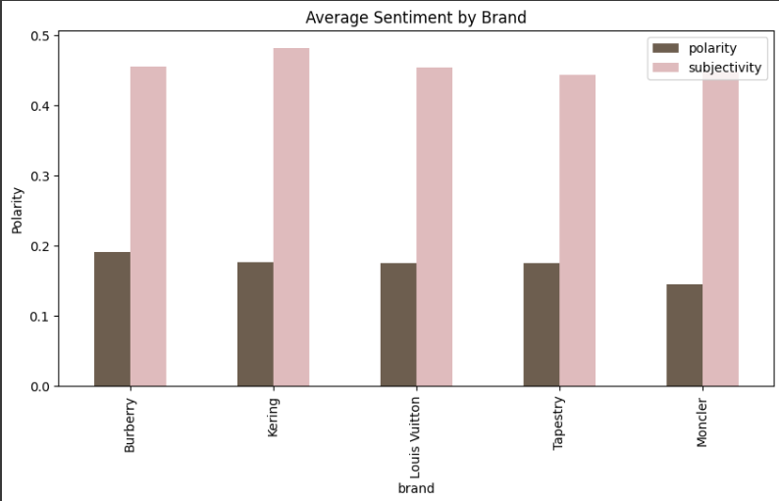
Polarity varies slightly across brands
Subjectivity is consistent across brands
Media tone is generally positive-neutral
Subjectivity scores are consistent, suggesting that most articles maintained a balanced or informative tone.
Notes:
This chart shows the average sentiment scores for each brand in our analysis, split into two components: polarity and subjectivity.
Polarity reflects the emotional tone—positive or negative—while subjectivity measures how opinion-based the content is.
We see that all brands generally have low-to-moderate polarity, meaning media coverage tends to lean slightly positive but not strongly so.
Kering and Burberry have slightly higher polarity scores compared to others, while Moncler has the lowest.
Subjectivity scores are fairly consistent across all brands, suggesting that most articles maintain a balanced or informative tone, rather than highly opinionated language.

Slide 28
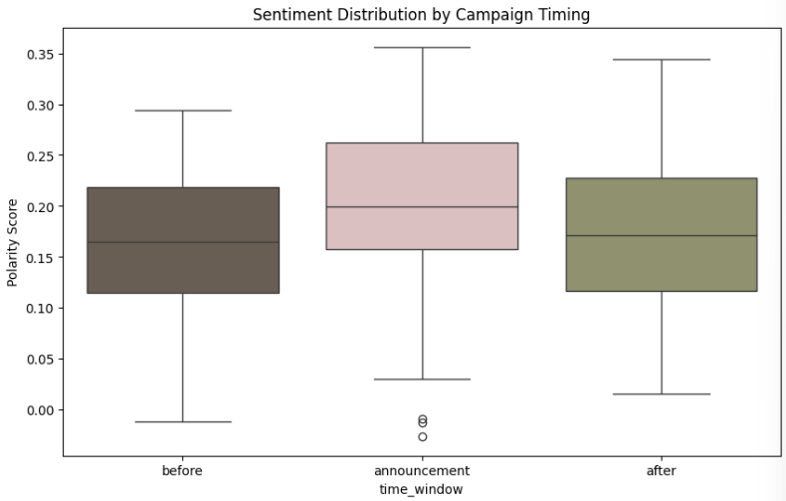
Sentiment increases around announcement
Before and after are similar
Variation is highest during announcements
Tone remains generally positive
News articles were generally neutral to positive across all phases of an announcement.
Notes:
This boxplot shows how sentiment, or emotional tone, shifts across three phases of an ambassador campaign: before, during the announcement, and after.
We see the highest median sentiment during the announcement phase, suggesting that media coverage tends to be most positive at the moment the campaign launches.
Before and after the announcement, the sentiment is slightly lower and more consistent, showing that this campaign moment causes a temporary lift in tone.
There’s also more variability during the announcement window — the range of sentiment is wider — which may reflect differing opinions, interpretations, or simultaneous events being covered in the same articles.
Overall, sentiment remains above zero throughout, indicating that articles were generally neutral to positive across all phases.

Slide 29
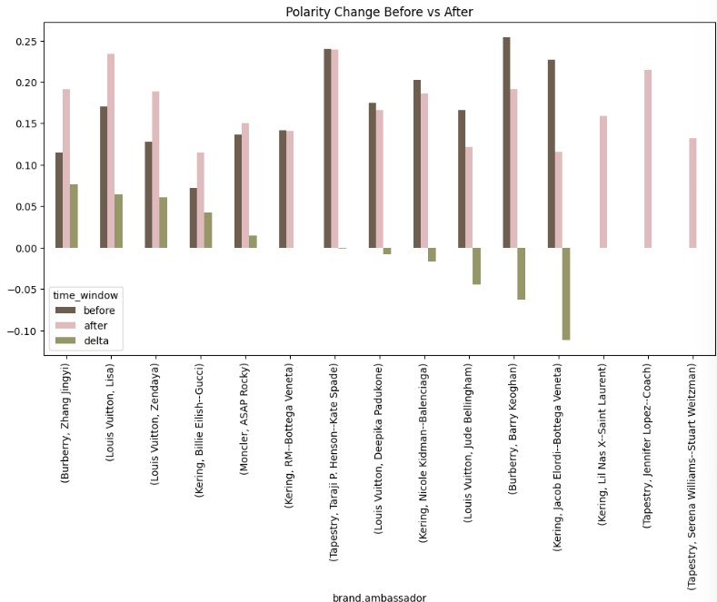
Majority of ambassadors show increased sentiment post-announcement
Mixed media response suggests varied impact by campaign
Understanding how each ambassador individually impacted tone, while seeing the diversity in outcomes.
Notes:
This chart breaks down the sentiment change for each ambassador by comparing sentiment scores before and after their announcement.
The bars in brown and pink represent average sentiment before and after, respectively. The green bar, or delta, represents the change in sentiment—positive or negative.
Most ambassadors show a slight to moderate increase in sentiment, suggesting their announcements were received positively by the media.
However, we also see that some ambassadors had a drop in sentiment after the announcement, like Barry Keoghan and Jacob Elordi. This could be due to other overlapping campaigns, public reactions, or unrelated news coverage during that time.
This plot helps us isolate how each ambassador individually impacted tone, while also highlighting the diversity in outcomes across campaigns.

Slide 30
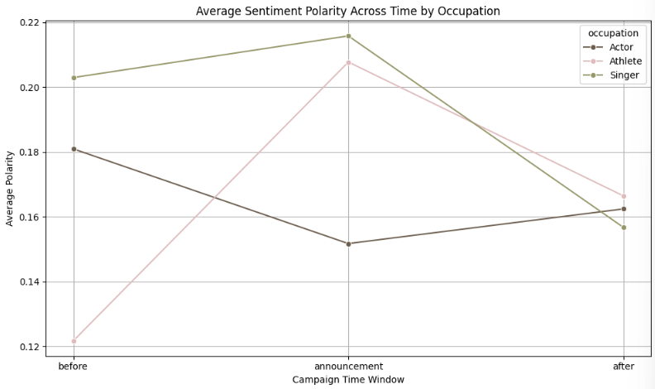
Athletes show the sharpest sentiment increase at announcement
Singers maintain highest overall sentiment
Actors being higher but decline post-campaign
Occupation plays a role in how campaigns are received, possibly due to audience expectations.
Notes:
This line chart shows how sentiment changed over time based on the occupation of the ambassador—actors, athletes, and singers.
We can see that athletes experienced the most dramatic increase in sentiment at the time of the announcement, suggesting media responded especially positively to their campaigns.
Singers maintained the highest overall sentiment levels across all phases, although their positivity declined after the announcement.
Actors, by contrast, started with relatively higher sentiment before the campaign, but their coverage became more neutral over time.
These trends suggest that occupation plays a role in how campaigns are received, possibly due to audience expectations or the way different celebrities are positioned by the brands.

Slide 31
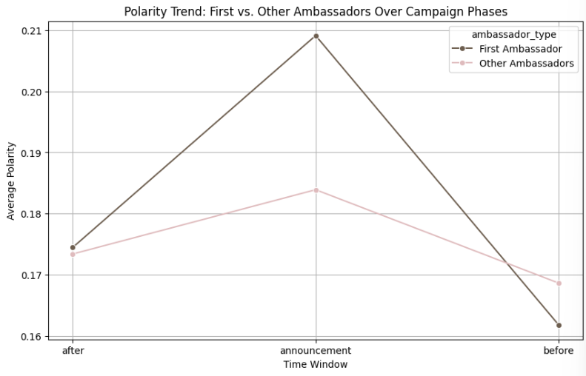
First ambassadors show strongest sentiment spike at announcement
Other ambassadors show more consistent sentiment over time
First-time ambassador campaigns may carry more novelty or news value, generating a more enthusiastic media response.
Notes:
This chart compares the sentiment trends over time between a brand’s first-ever ambassador and subsequent ambassador campaigns.
We see that first ambassadors experienced the most notable spike in sentiment during the announcement phase, reaching the highest average polarity overall.
Interestingly, they also started with a lower baseline of sentiment before the announcement, which suggests that the campaign itself may have played a stronger role in driving media positivity.
In contrast, other ambassadors show a more stable trend with less dramatic shifts in sentiment across all phases.
This indicates that first-time ambassador campaigns may carry more novelty or news value, generating a more enthusiastic media response during launch.

Slide 32
Key Findings: Sentiment
Ambassador Campaigns Influence Sentiment
Small but noticeable shifts in media sentiment occurred after ambassador announcements.
Occupation Matters
Athletes showed the strongest positive sentiment change; actors remained relatively flat.
First Ambassadors Have Greater Impact
First-time ambassadors triggered sharper sentiment increases during announcement periods than follow-up ambassadors.

Slide 33
05
Search Interest

Slide 34
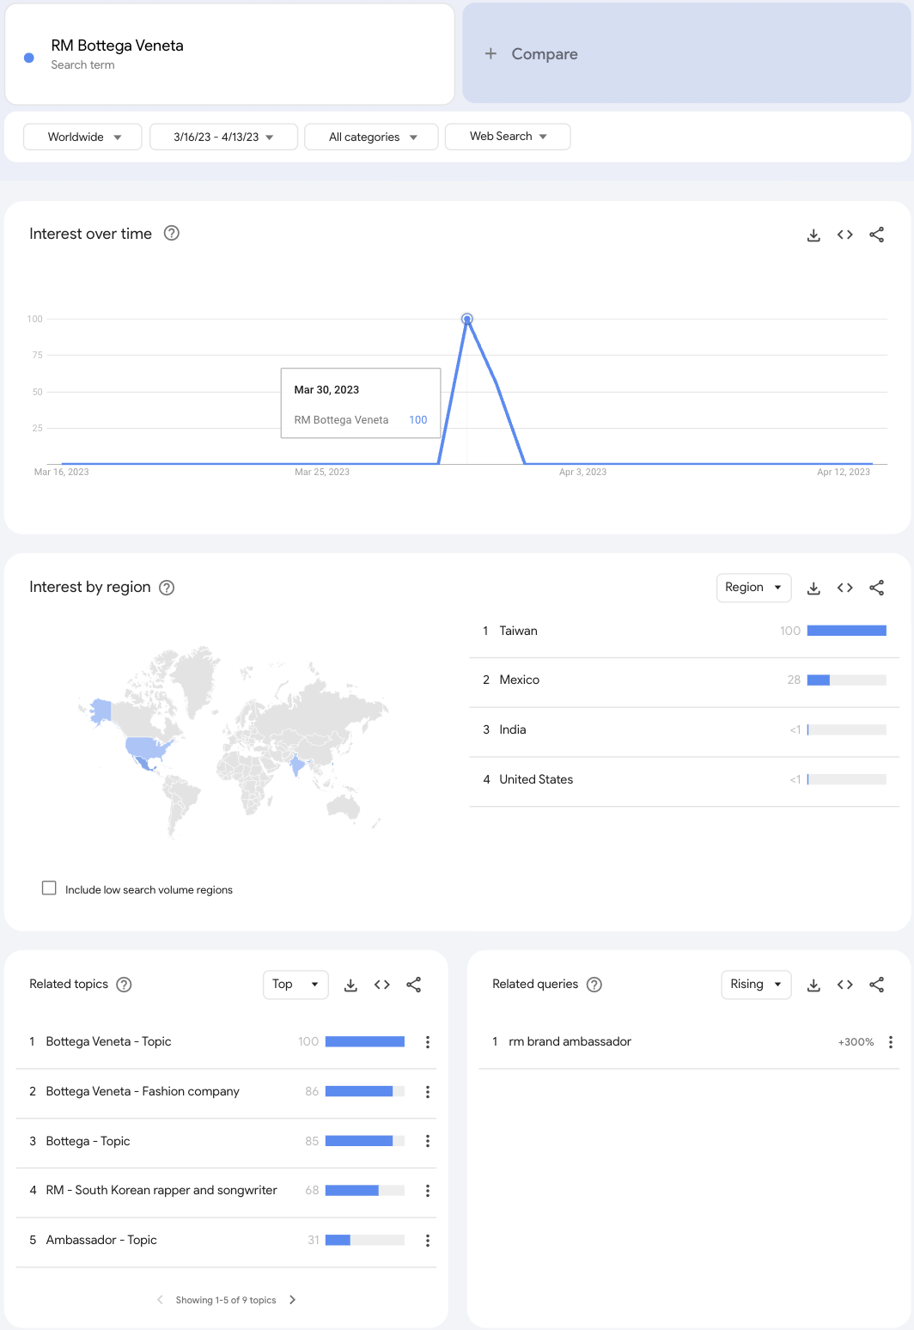
Search Interest
Objective
Measure the effect of ambassador announcements
on public search interest
How we measured
Time Frame: T–14 to T+14 (before and after announcement)
Metric: Search interest (0–100 index)
Region: Country/region level
Query Types: (i) Brand only – Brand awareness
(ii) Ambassador only – Public reach (iii) Brand + Ambassador – Personalized engagement
Observation: Search interest spiked immediately after announcements, signaling heightened public engagement.
Data Source: Google Trends

Slide 35
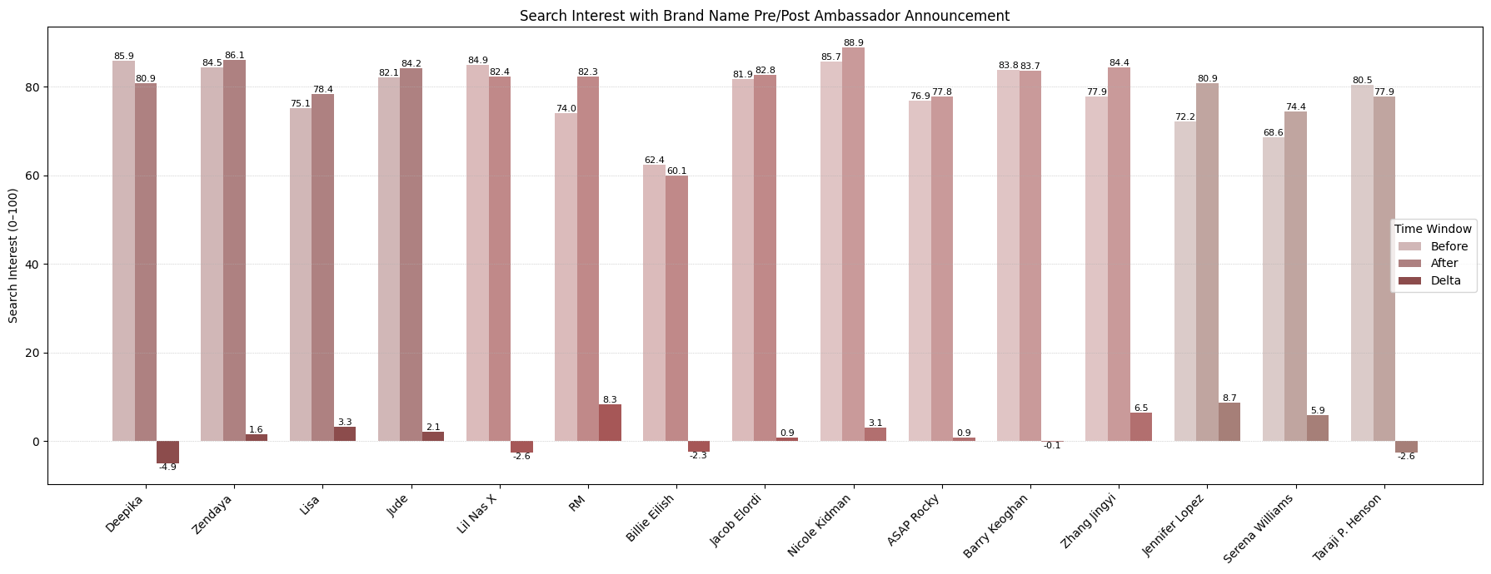
Impact on Core Brand Awareness
Announcements often elevate ambassador visibility more than core brand interest.

Slide 36
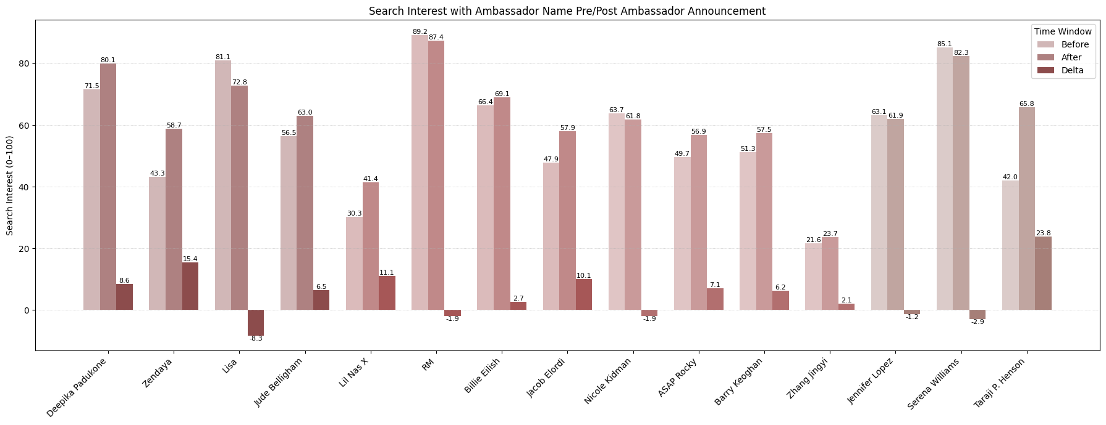
Ambassador Visibility & Earned Media Value
Ambassadors can drive significant visibility, often eclipsing the brand in public interest shortly after announcement.

Slide 37
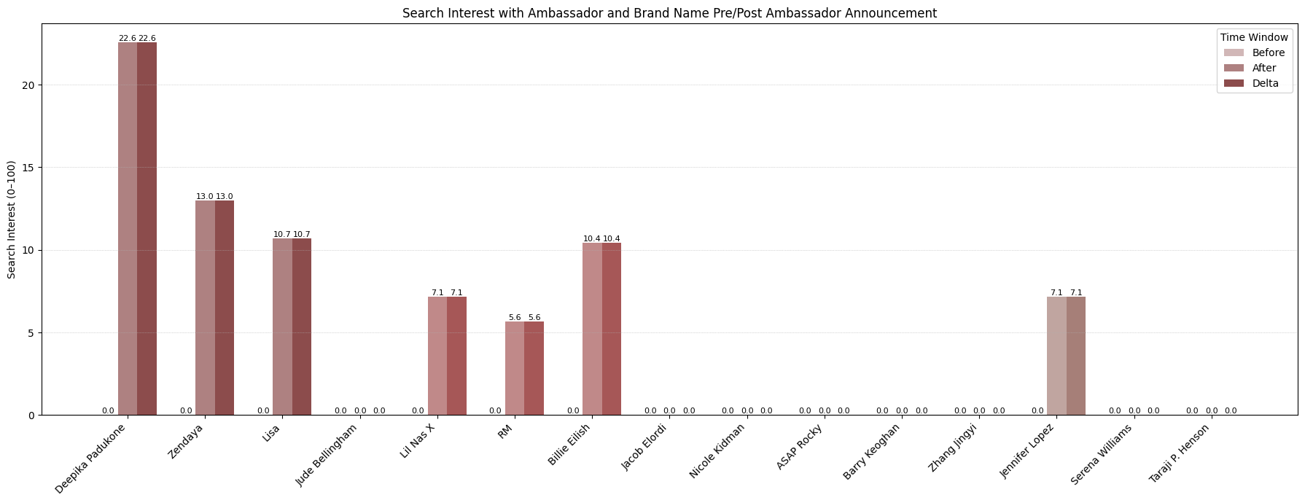
Brand-Ambassador Association Effectiveness
Co-branded campaigns tend to be short-lived, and many ambassadors fail to generate enduring brand recall.

Slide 38
Key Findings: Search Interest
Search Spikes Post-Announcement Public interest rises sharply in the 2 weeks after announcements.
Ambassadors > Brands in Visibility Search interest often favors the ambassador more than the brand.
Athletes Drive Stronger Spikes Especially effective in generating immediate public attention.
First-Time Ambassadors = Highest Impact Novelty effect leads to stronger, short-term engagement.

Slide 39



Conclusion
Market Response
Audience Resonance
Campaign Effectiveness
Ambassador campaigns
influence stock returns,
brand image, and public
attention.
Impact varies by occupation — actors drive stronger financial effects; athletes boost sentiment and search visibility.
First-time ambassadors
consistently outperform follow
ups, benefiting from novelty and
exclusivity.
Strategic Ambassador Selection Drives Business Impact

Slide 40
Thanks!

